Slide 1
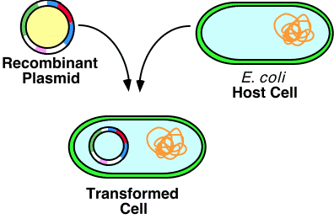
Recombinant DNA

Slide 2
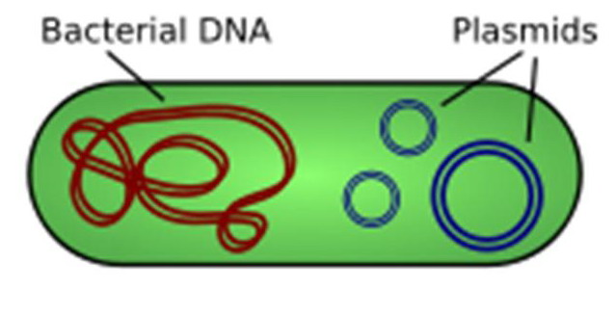
Bacteria
Prokaryotes → no nucleus
Bacteria have plasmids
plasmid = circular DNA molecule

Slide 3
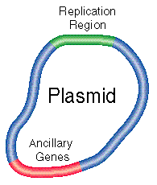
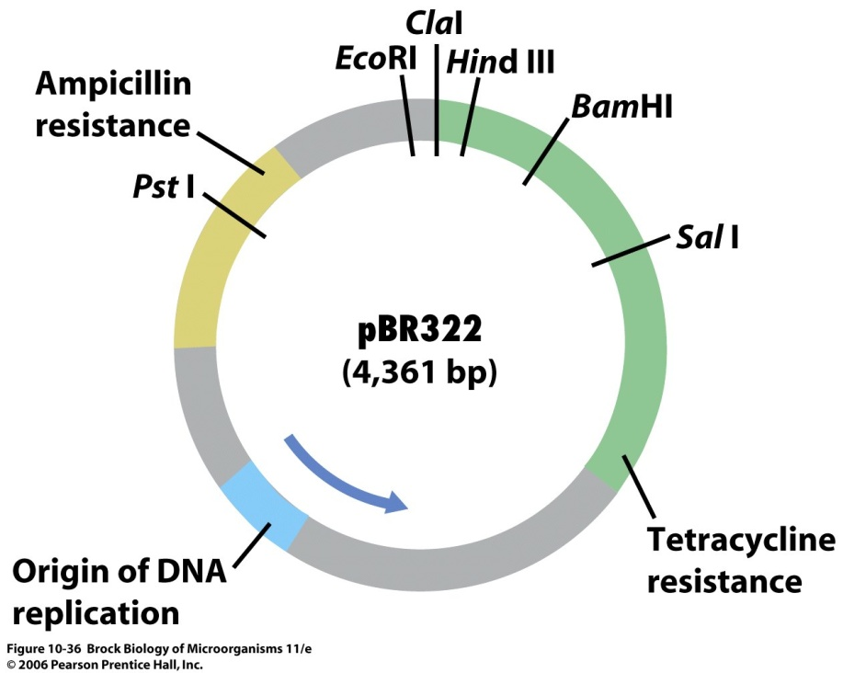
Plasmids
Plasmids have DNA sequences to promote replication
Restriction sites – sequences cut by these enzymes
Gene for antibiotic resistance – naturally occurring in some bacteria

Slide 4
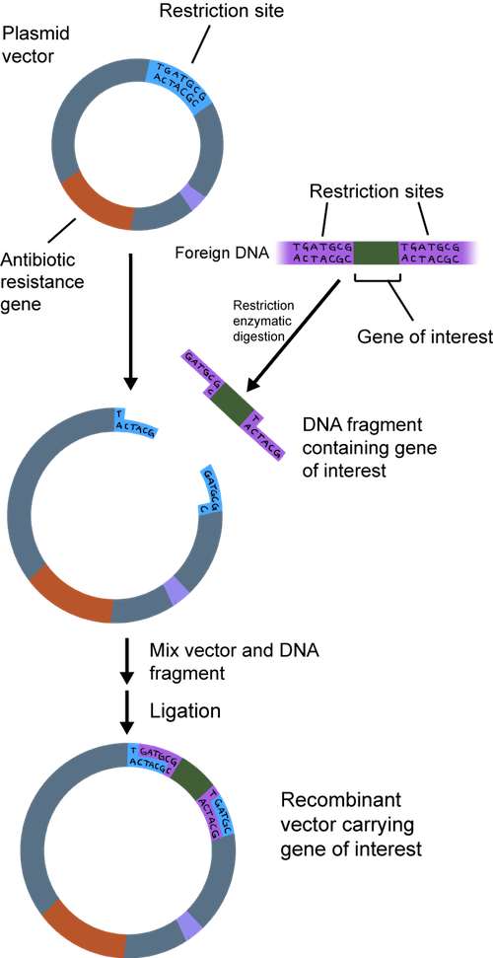
Transformation
= a cell takes in foreign DNA to make it a part of its own original DNA
1) free DNA in environment
2) extracted DNA
3) DNA from another bacteria is copied & transferred
Recombinant DNA is formed
= DNA produced by combining DNA from different sources
Plasmid is inserted into a bacterial cell

Slide 5
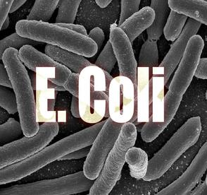
Recombinant DNA Technology
http://www.sophia.org/tutorials/recombinant-dna-technology--2
Try the 4 minute tutorial above. Try to answer the 3 “quiz” questions to the right of the video.

